Slide 1
Analyzing Strengths and Weaknesses of Northeast 10 Conference Basketball Teams

Slide 2
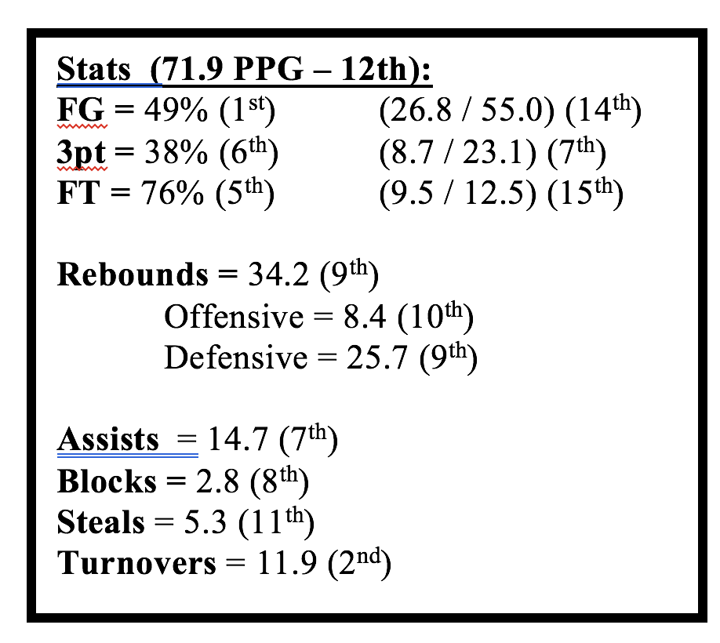
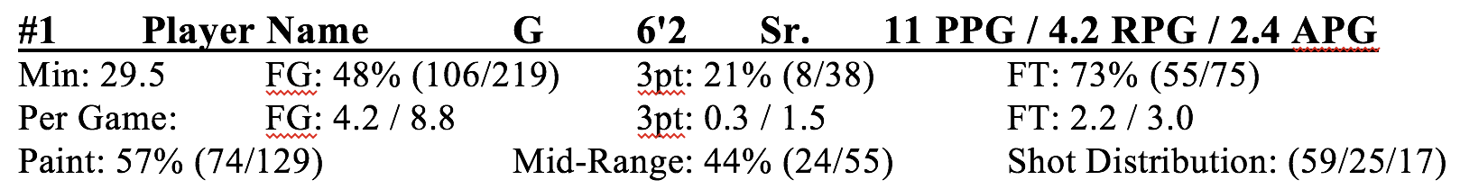
Overview
My Role: Graduate Assistant for the Saint Rose Men’s Basketball Team
Create scouting reports using basic stats & analysis
The concept: How can I utilize techniques learned in class to gain a better understanding of teams in our league?

Slide 3
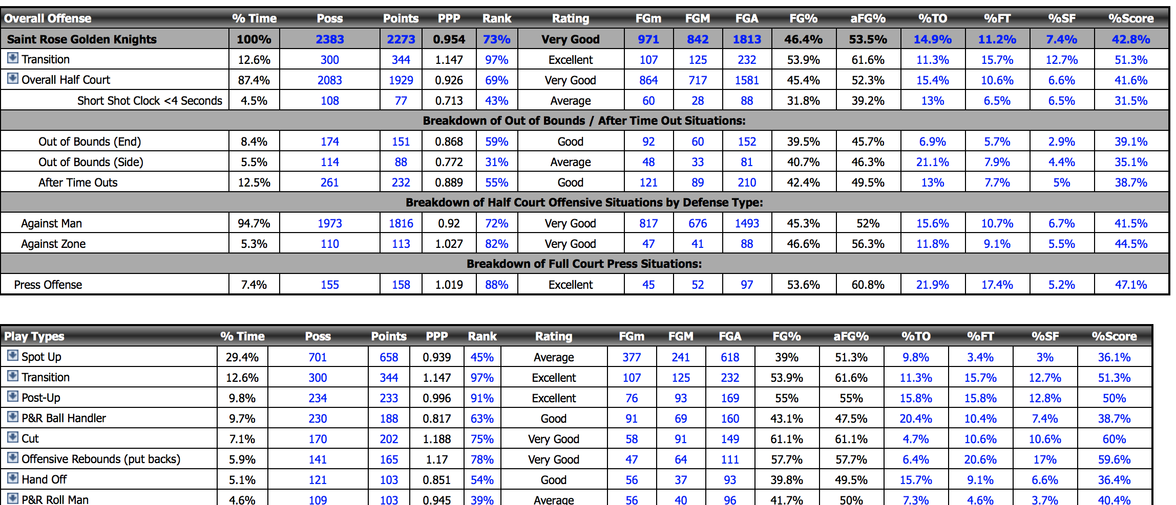
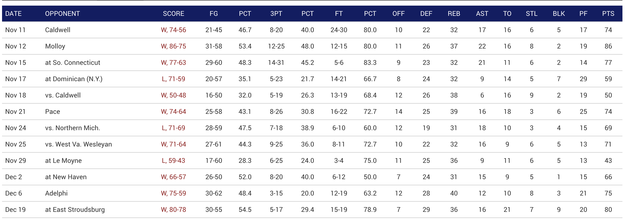
Initial Roadblocks
Near endless supply of data – what to use?
Analyze individual players or teams as a whole?
Use statistics from each game, or the entire season?
Utilize advanced analytics from Synergy, or basic box score stats?
Solution: Limit scope. Analyze teams using box scores from each game
How to collect data?
Copy and pasting to excel possible, but incredibly tedious
Solution: Python web scraping with Beautiful Soup

Slide 4
Python
Python’s Beautiful Soup package for web scraping
Connects to a web page, searches HTML code, pulls data out of user specified tags
Example: table = (soup.find_all('table')[0]) – sets table variable to the first table in the HTML document
Limited experience in Python, and no experience with Beautiful Soup
Not exactly a walk in the park, but not impossible to figure out
Many resources online – StackOverflow incredibly helpful
Overall:
Estimated 10 hours of coding, tinkering, & debugging
200 lines of code – Extracts data from HTML, formats, and saves to CSV file
Experienced Python devs may find the code to be written terribly, but it gets the job done
Largely unneeded / outside the scope of this project, but worth it!

Slide 5
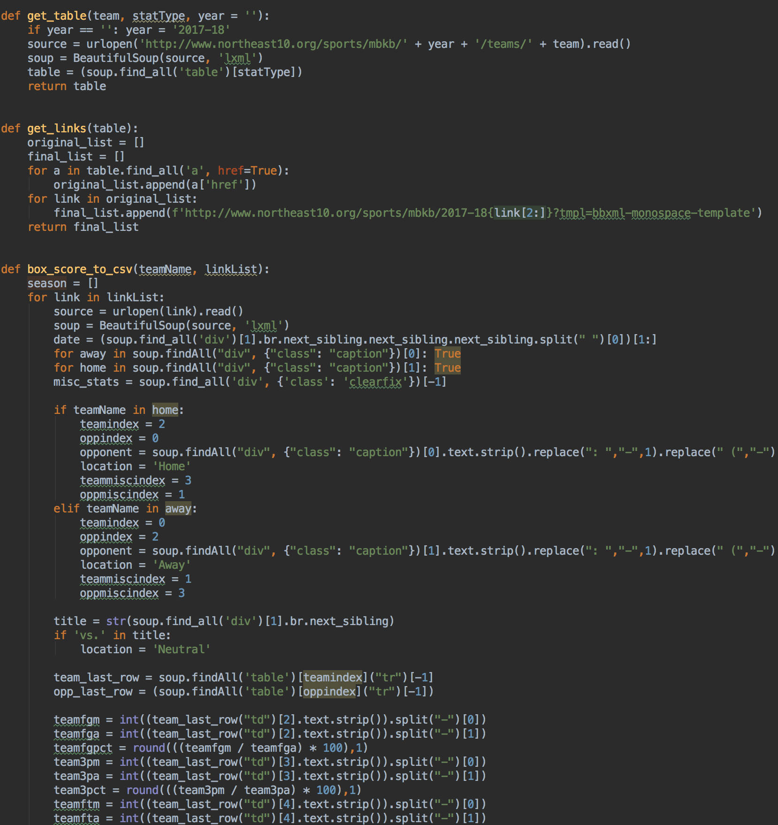
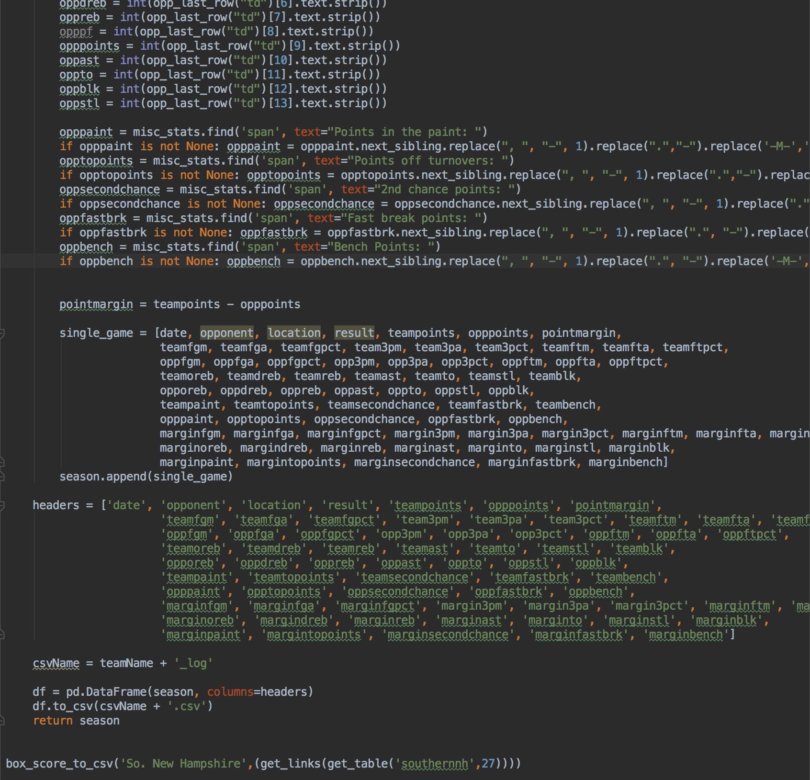

Slide 6
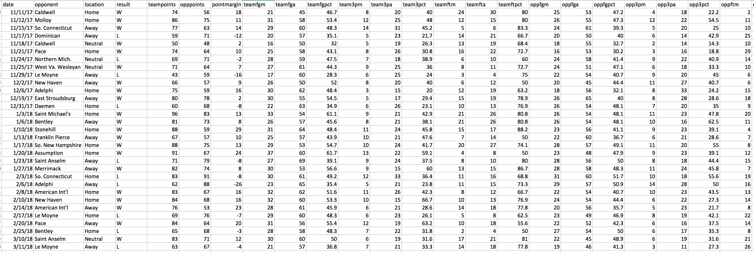
Data
70 Variables:
4 based on the game (Date, Location, Opponent, Result)
33 for the team and 33 for their opponent:
Points scored
Shooting stats (FG, FT, 3P – made, attempted, percentage)
Ball control (Offensive & Defensive rebounds, blocks, steals, assists, TO)
Points in paint, points off turnovers, second chance, fast break points, points off turnovers
Margins for every stat (team stat – opponent stat, i.e. team has 40 rebounds, opponent has 35, rebound margin = +5)
Around 25-30 observations (games) for each team

Slide 7
Models Used
Decision trees based on result
Fit Y by X to find variables correlated to result
Linear regression on seemingly important variables
Logistic regression based on result (not helpful)

Slide 8
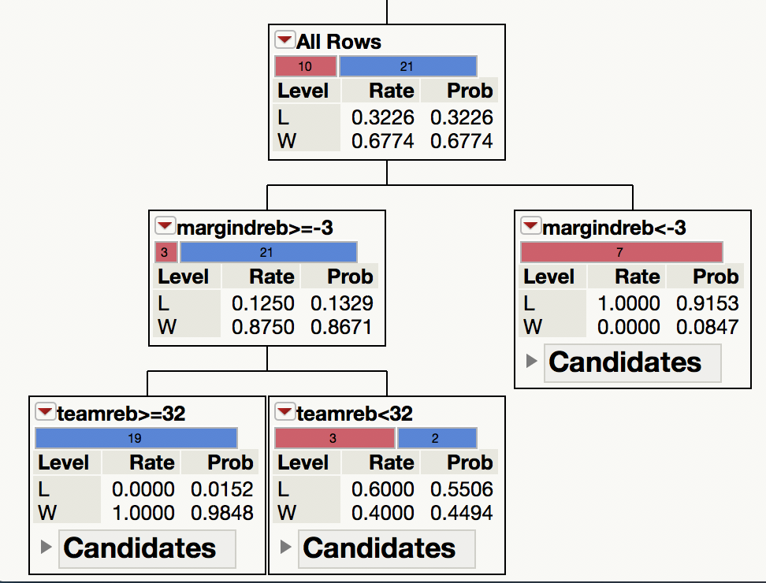
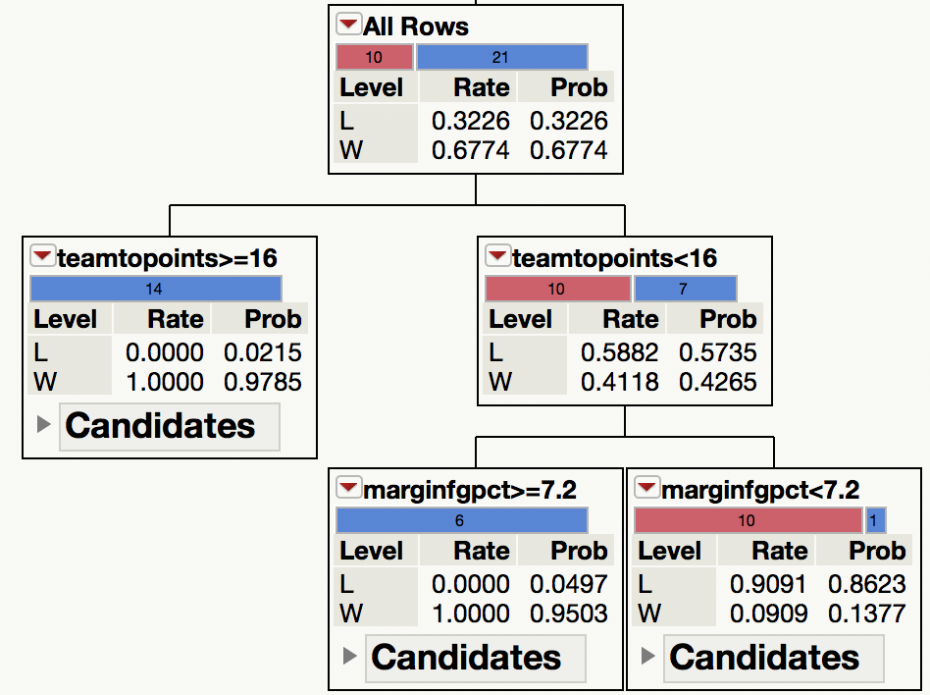
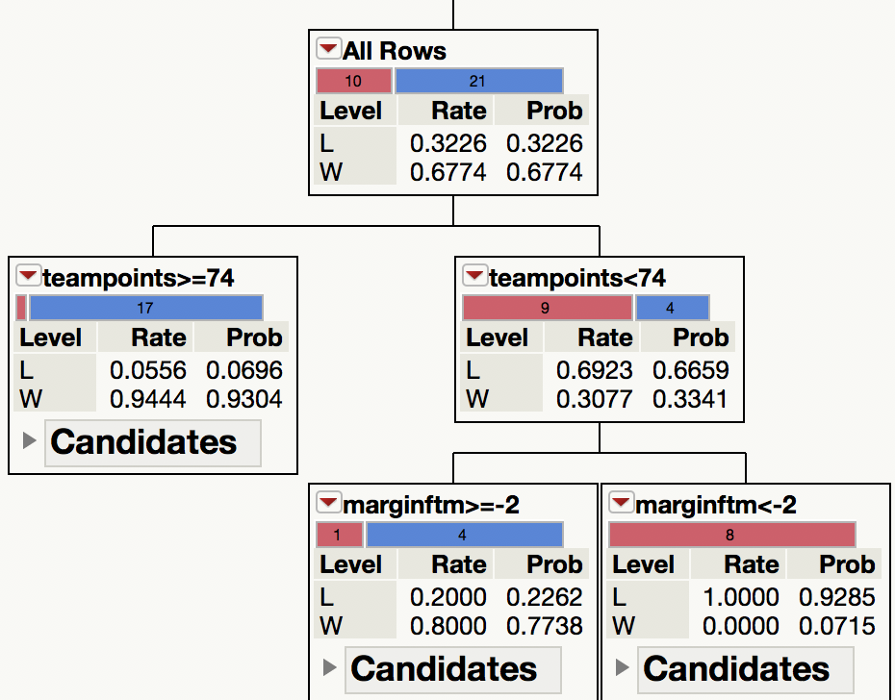
Saint Rose Analysis
What are our strengths?
0-7 When opponent has 4+ more defensive rebounds
21-3 When the defensive rebound margin is between +∞ and -3
19-0 with 32+ total rebounds
2-3 with under 32 rebounds
14-0 when we score 16+ points off opponent turnovers
7-10 otherwise
6-0 if our field goal percentage is more than 7.2% greater than the opponent
1-10 if it is less than 7.2%
17-1 when we score 74+ points
4-9 when we score less than 74
4-1 when we make 2+ more free throws than the opponent
0-8 otherwise

Slide 9
Saint Rose Analysis
What does this mean?
Place a strong emphasis on rebounding!
When we control the glass, we control the game.
Pace and tempo – more shots lead to more rebounds
Defensive disruption and shot selection - “The best offense is a good defense.” Turnovers lead to fast breaks which lead to easy shots.
If our defense isn’t generating points, we must emphasize taking high percentage shots on the offensive end
We’re hard to beat in a higher scoring game – this once again favors a high paced up tempo offense
Still capable of winning low scoring affairs, but need to work the ball in the paint and get to the free throw line

Slide 10
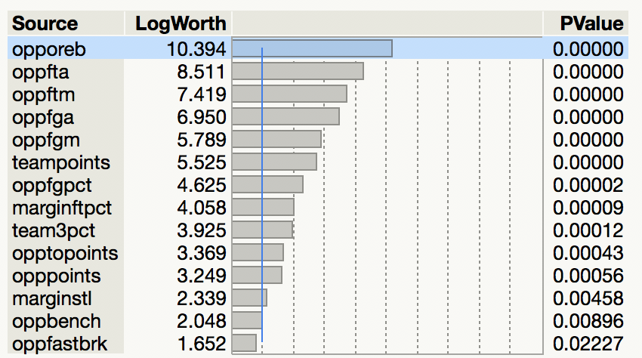
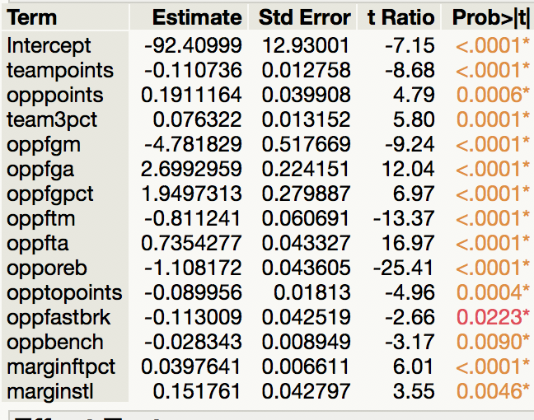
Defensive Rebound Analysis
League wide rebound statistics & stepwise regression analysis
Every conference opponent we lost to averaged more defensive rebounds on the season
What goes in to a defensive rebound?
Seemingly obvious: Opponent offensive rebounds, opp FG makes / attempts / percentages
Interesting insight: Free throws, opponent steals / points in transition

Slide 11
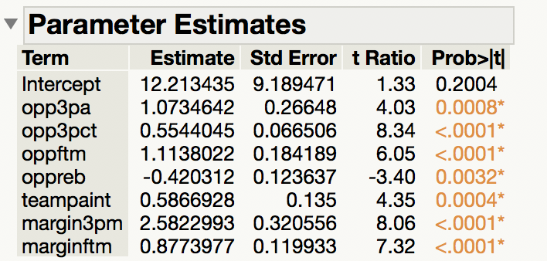
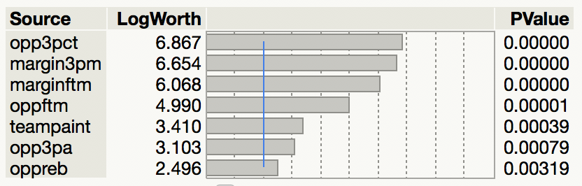
Points Scored Analysis
Stepwise analysis for points scored
Removed variables such as team shot makes, attempts, and percentages
Potential Causes for these findings:
As opponent baskets increase, Saint Rose baskets must increase to keep pace and win
Opponents gather more rebounds when Saint Rose baskets are not falling
Points in the paint are more efficient and and lead to a higher score
Run more plays for bigs inside to increase win probability?

Slide 12
Logistic Regression?
Not an applicable model for this data set
Seemed difficult for it to decipher between data that was or wasn’t important Possible reasons:
Many data points can fluctuate wildly – i.e. while more turnovers would typically lead to losses, you could still win a game with 20 turnovers or lose a game with 0
Too few observations?

Slide 13
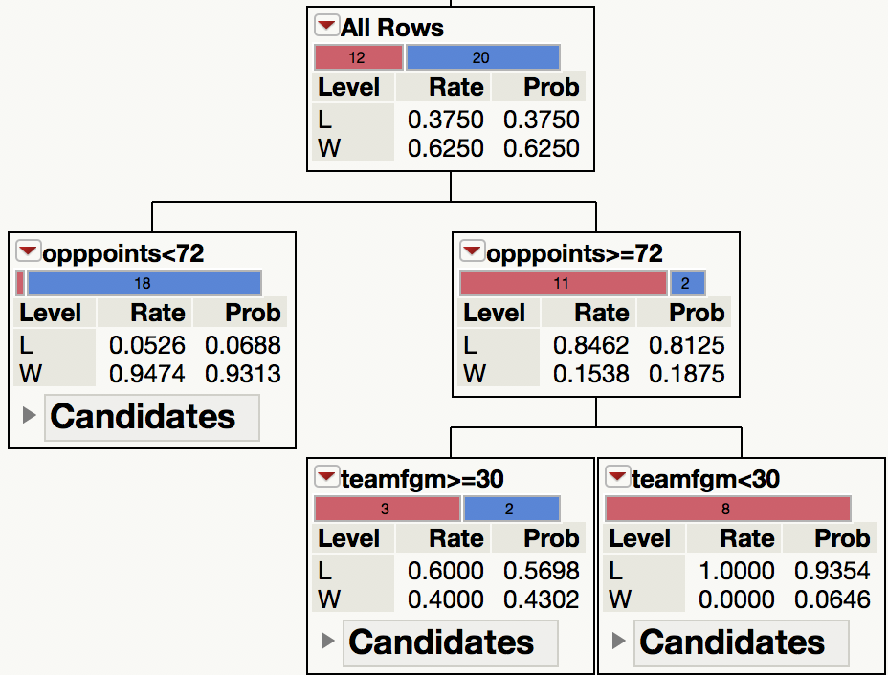
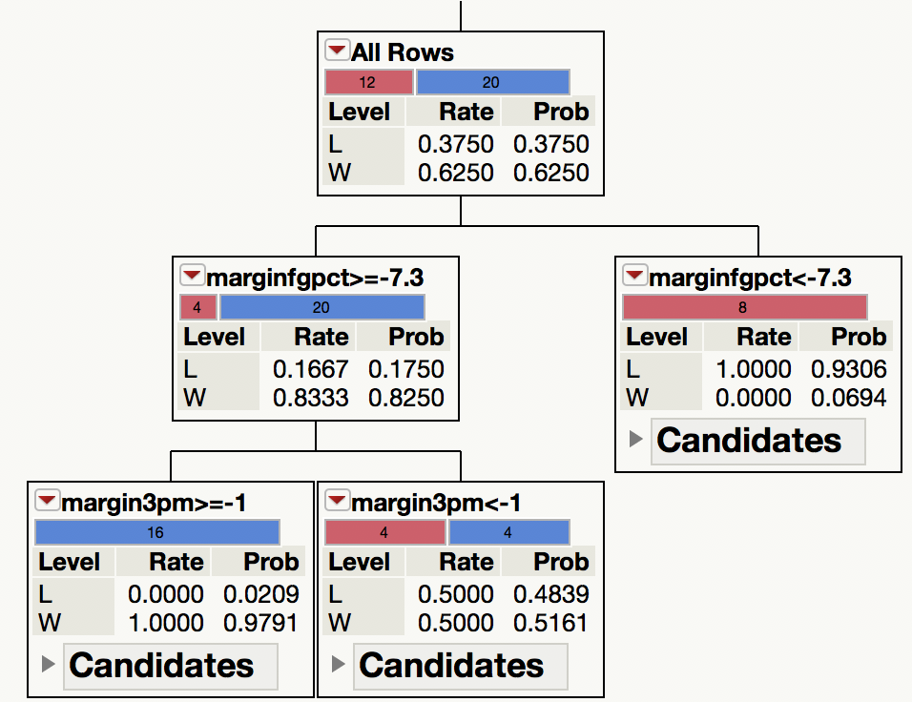
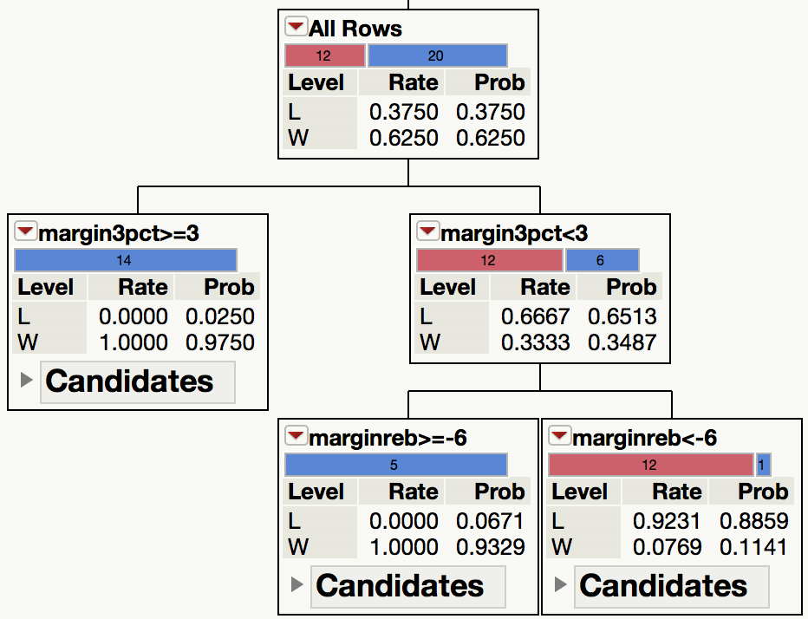
Opposition Research
Merrimack Warriors strengths & weaknesses (20-13)
Very good defensively
Struggle to win high scoring affairs
Plays to our advantage – high pace
Struggle to win against teams that shoot efficiently
Need to outscore their opponent from 3
Ineffective when they struggle to rebound
League Stats:
72.3 points allowed (4th) / Opponent 3P% = 36.2 (6th) / Team 3P% = 36.6 (12th)

Slide 14
Potential Issue?
As these data sets were taken from a completed season that just ended, there are many observations. What if we’re only a month into the season? Can we assume the analysis will be just as effective with a much smaller sample size?
NO – This is a valid concern. The decision tree will not work with less than 10 observations, and the analysis is less viable for better teams with less losses

Slide 15
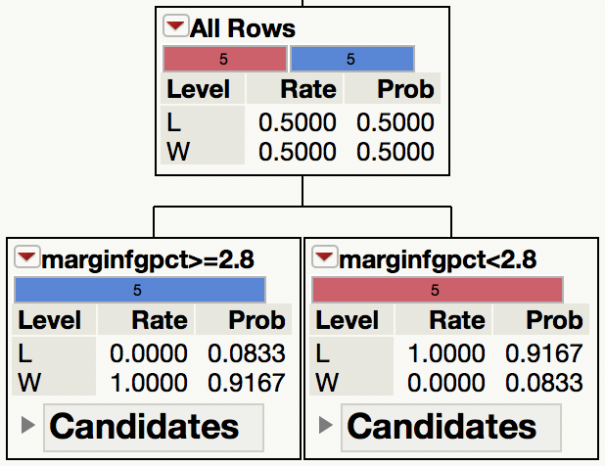
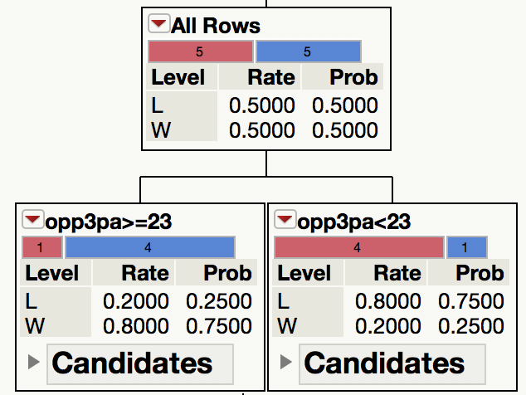
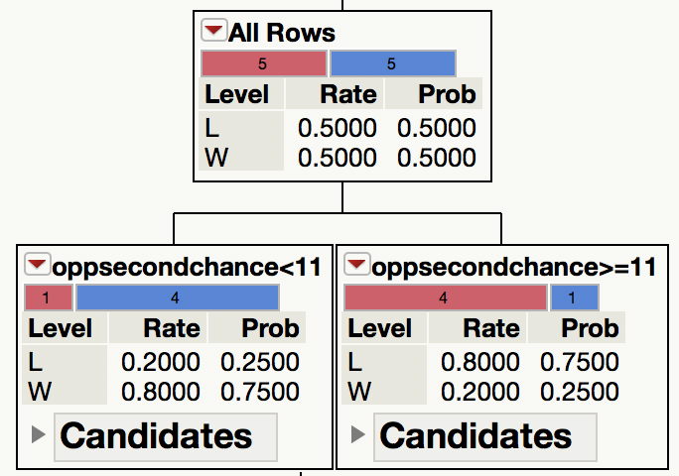
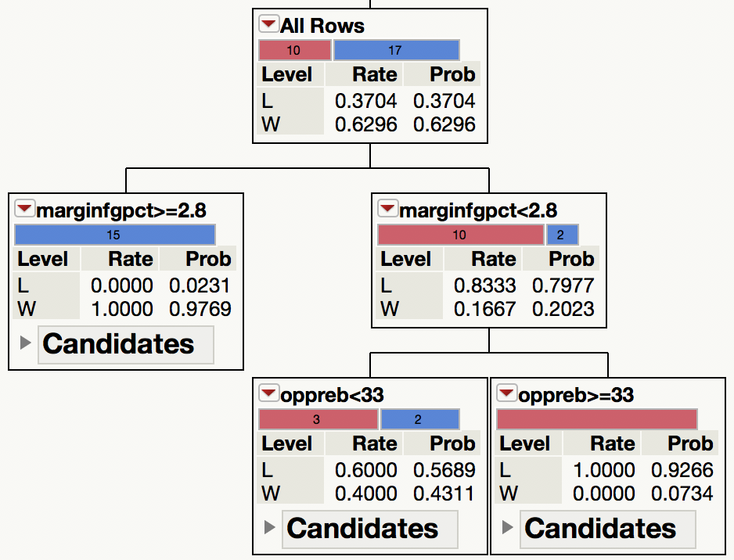
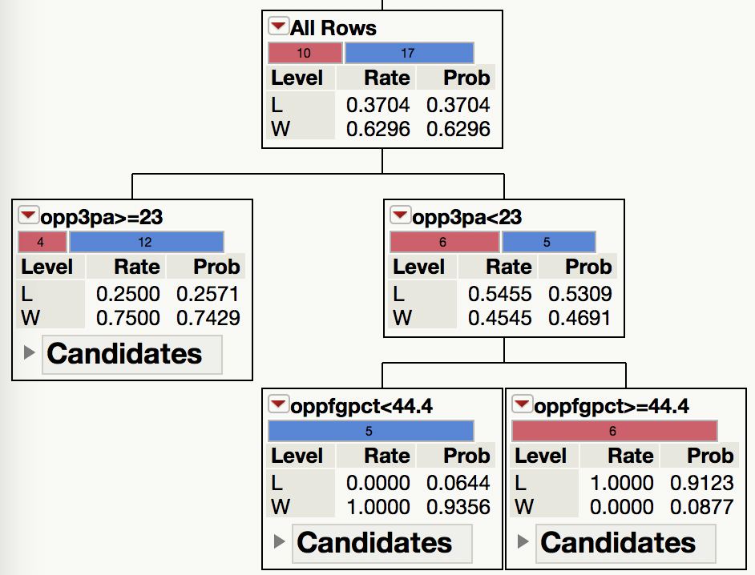
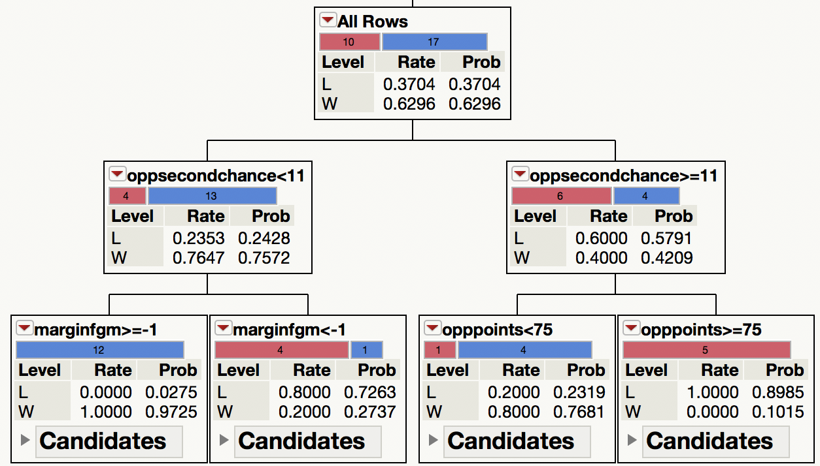
Analysis of Average Opponent
New Haven Chargers: 5-5 through 10 games, 17-10 for the year
Through 10
Full Season
(Same Variables)

Slide 16
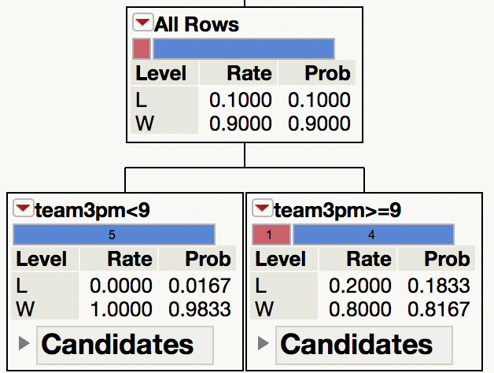
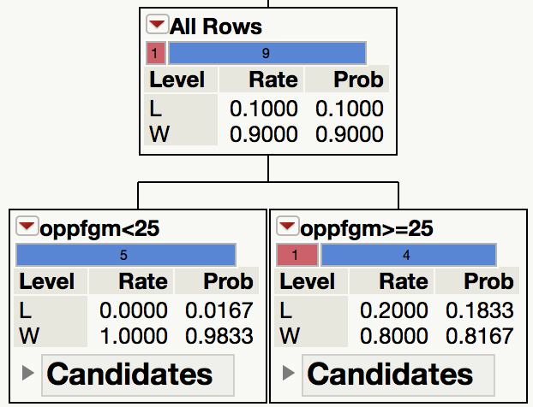
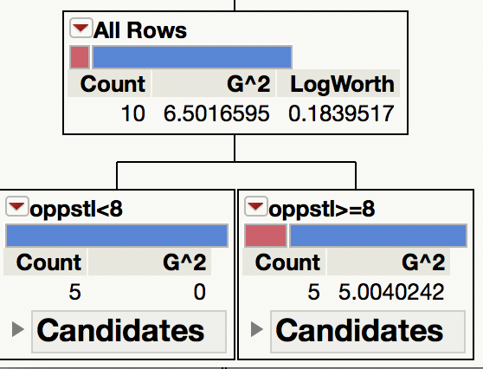
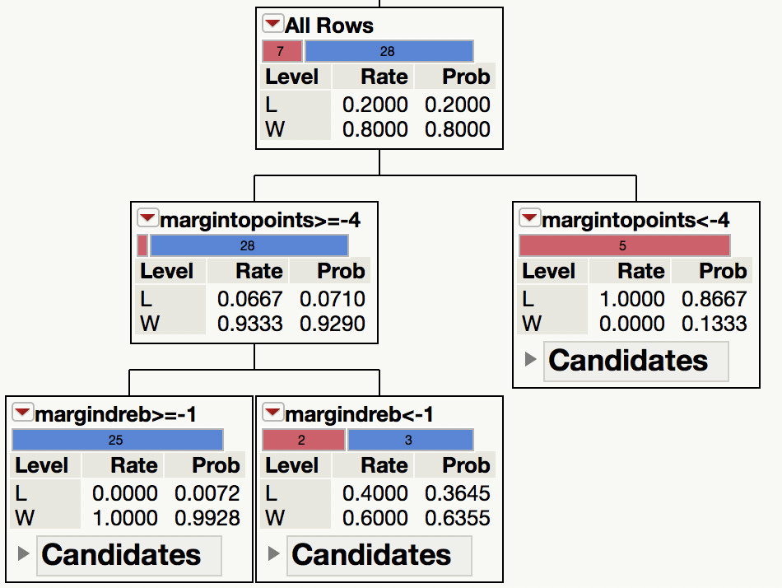
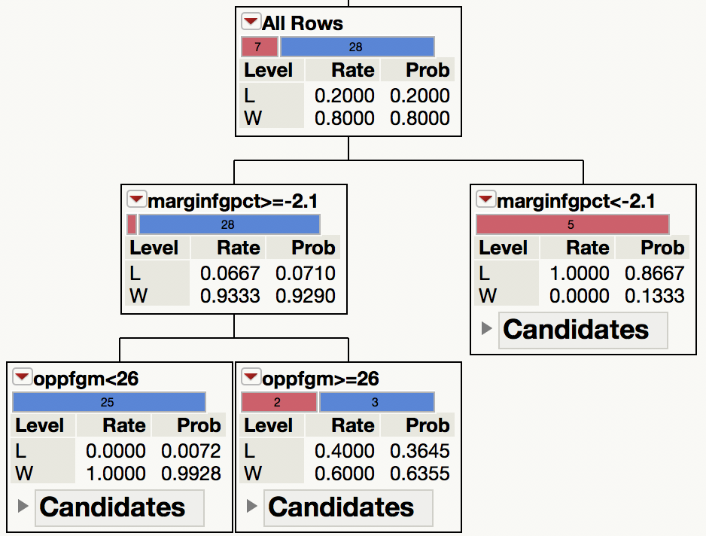
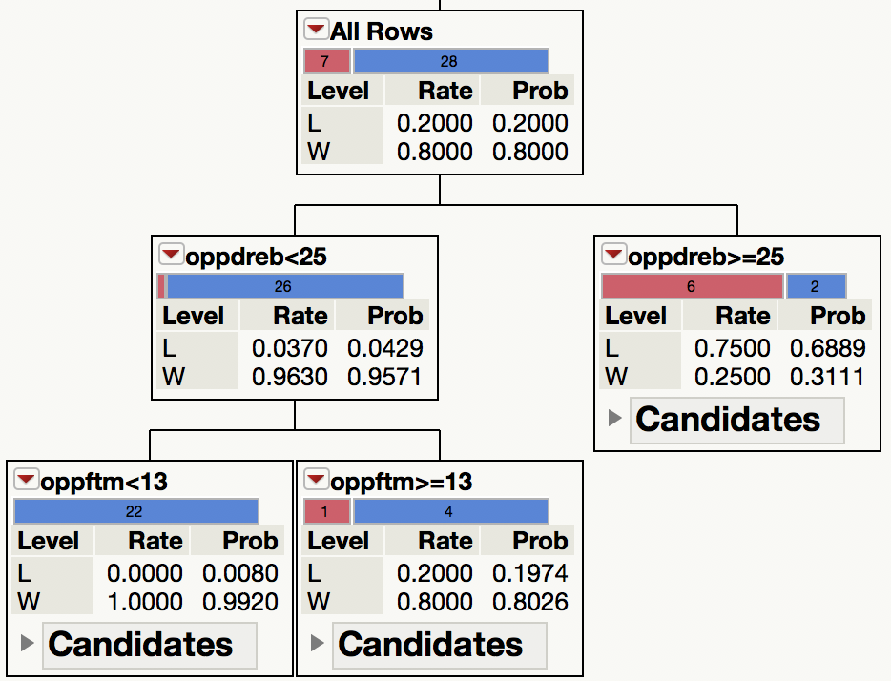
Analysis of Excellent Opponent
Le Moyne Dolphins: 9-1 through 10 games, 28-7 on the year
Through 10
Full Season (System Generated Variables)

Slide 17
Future Possibilities
More Python: Optimize the system for non technical users (coaches)
Learn and utilize data science packages such as NumPy, MatPlotLib, and Scikit-Learn
Remove the need for the awkward step between Python and SAS JMP
Possible GUI to hide complicated code
More Data
Player integration: How does the performance of individual players impact the result?
Learn, calculate, and implement advanced metrics such as PER, pace, ORTG, DRTG, etc.
Analyze data from previous seasons to see if teams are likely to have similar play styles from year to year (historic data may be helpful to apply early in the following season)
Fix & improve existing Python code
Many items hard coded, what happens if / when the website changes?
Gain a better understanding of Beautiful Soup to increase longevity of the program

